Slide 1



Implementation of Chatbot Using NLP
By:
Sujal Gowda JM

Slide 2

Learning Objectives
Understanding Natural Language Processing (NLP)
Implementing Text Classification using Logistic Regression
Working with TF-IDF Vectorization
Deploying a chatbot using Streamlit
Understanding intent-based chatbot development
Handling user input and responses dynamically
GOAL
Source :
www.freepik.com/

Slide 3
Tools and Technology used
Programming Language: Python
Libraries Used:
Scikit-Learn (for ML models)
NLTK (for NLP)
Streamlit (for web interface)
Data Format: intents.json (Stores chatbot responses)
Development Environment: Python & Jupyter Notebook
Machine Learning Technique: Logistic RegressionText
Processing: TF-IDF Vectorization
Deployment Framework: Streamlit (for creating UI)

Slide 4
Methodology
Data Collection: Used a pre-defined dataset (intents.json) containing intents, patterns, and responses.
Pre-processing: Tokenization using NLTK Vectorized input text using TF-IDF (Term Frequency - Inverse Document Frequency)
Model Selection & Training: Used Logistic Regression from Scikit-Learn trained the model on extracted features from intents.json
Response Generation: User input is transformed into a TF-IDF vector. The trained Logistic Regression model classifies the intent. The chatbot selects a random response from the corresponding intent and displays it.
User Interface: Streamlit used for creating a simple web-based chatbot interface. Users type their input, and the chatbot provides relevant responses

Slide 5
Problem Statement:
Implement an NLP-powered chatbot that accurately understands user intent and provides relevant responses using Logistic Regression and an intents-based system. The chatbot will feature a user-friendly Stream-lit interface, ensuring efficiency, scalability, and improved user engagement

Slide 6
Solution:
Developed an AI-powered chatbot using Natural Language Processing (NLP).
Machine Learning based text classification to identify user intent.
Used TF-IDF vectorization for text preprocessing.
Logistic Regression model trained to classify user queries based on predefined intents.
Streamlit based UI for user-friendly chatbot interaction.

Slide 7
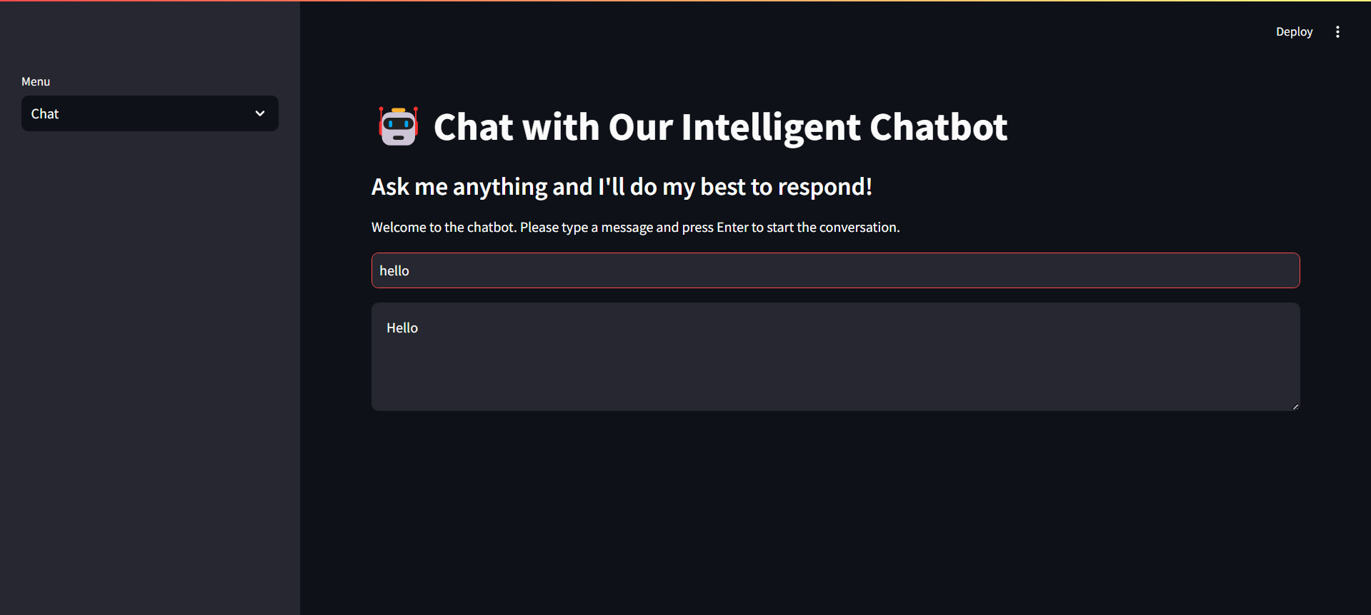
Screenshot of Output:

Slide 8
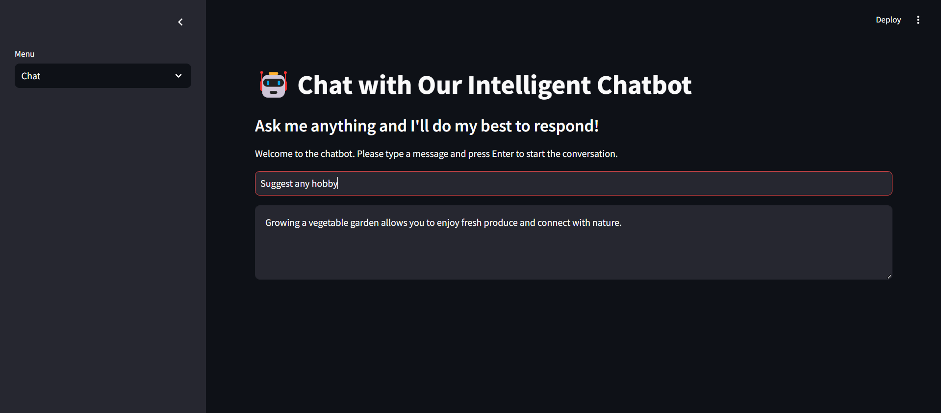
Screenshot of Output:

Slide 9
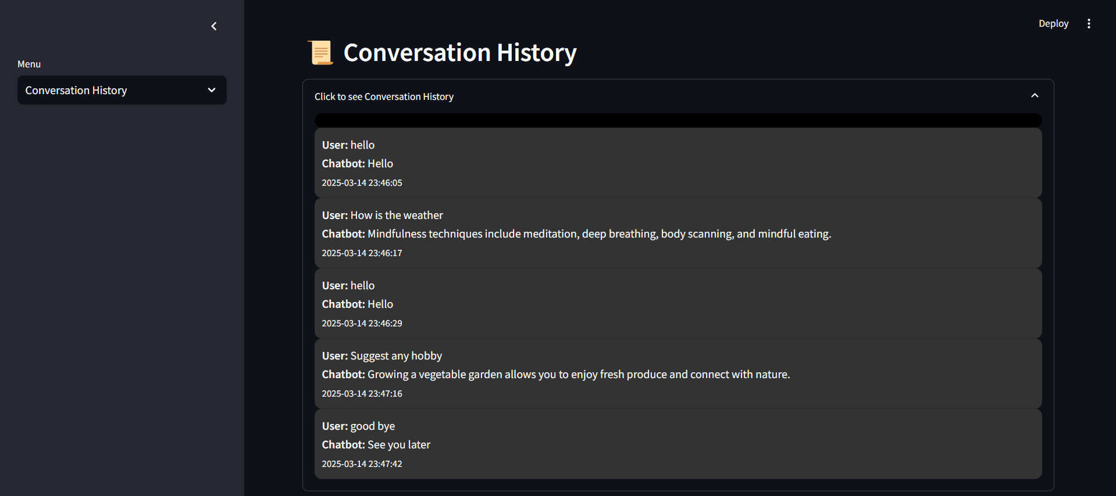
Screenshot of Output:

Slide 10
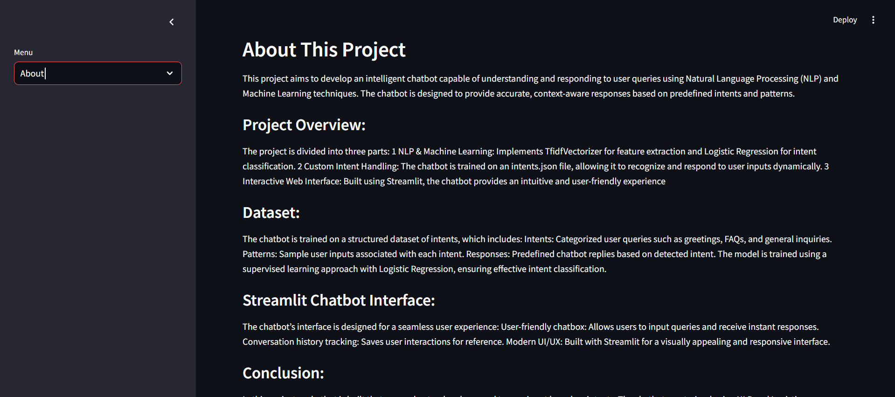
Screenshot of Output:

Slide 11
Conclusion:
Successfully implemented an NLP-based chatbot using Logistic Regression.
The chatbot can understand and generate appropriate responses.
Implemented a simple Streamlit UI for interaction.
Learned about machine learning, NLP, data preprocessing, and chatbot deployment.
Future Scope:
Implement Deep Learning models (e.g., RNN, LSTMs, Transformers)
Improve dataset for better response accuracy.
Enhance UI with a better design.
Deploy the chatbot on a cloud platform.
GitHub Repository Link : https://github.com/Mr-Suj/AICTE-Internship-ChatBot.git

